Slide 1
More Visual Basic and an Introduction to VBScript
Week 4

Slide 2
Introduction
We have examined two types of Basic compilers so far:
  The traditional BASIC in the first lecture;
  Visual Basic in the last two lectures (which will learn in a little more detail).
Since today’s world is web-centric we will go into VBScript.
  This will allow students to create web pages for the WWW.

Slide 3
Objectives of Today’s Class
Today we will do three (3) on-line tutorial:
  HTML (needed to use Visual Basic Script);
  A mini-course on active X VBScript;
  And the fourth Chapter of our online textbook titled:
    Graphics and simple animation
Also today we will examine a little more of the history of Visual Basic Through lecture.
The major objective of today’s lecture portion of the class is to introduce the following: Visual Basic Script (VBScript), WWW and HTML.

Slide 4
We can identify the following about Visual Basic
Is high-level as opposed to low-level
Is Event oriented as opposed to procedure oriented. In a procedural programming language there is always a beginning, middle, and an end (remember our first program is standard BASIC).
High-visual Uses a Graphical User Interface (GUI).

Slide 5
We can identify the following about Visual Basic
Interpreted in development stage (we press the run button to test the program the program is interrupted rather than compile).
Can be compiled. The runtime file - msvbvm60.dll usually found in the System directory is needed to run a Visual Basic application without the Visual Basic program.

Slide 6
We can identify the following about Visual Basic
Using Visual Basic we will create forms (windows) and the code that will be executed when an “event” happens.
The environment we use to develop VB applications is called an Integrated Development Environment or IDE.

Slide 7
Versions of Visual Basic
1991 1.0
      Released by Microsoft
1992 2.0
      Faster
1993 3.0
      Simple way to control databases
1995 4.0
      Supports 32-bit processing. It generates 32-bit applications for Windows 95 or NT. Began providing developers with some object-oriented capabilities.
1997 5.0
      New interface. Programmers can create their own controls.
1998 6.0
      Includes new data access and Web development features.
2002 .NET
      Major changes (among other things) enhances Internet Application

Slide 8
How did we Get to Visual Basic (VB)?
VB is referred to as Rapid Application Development (RAD) tool.
Also, VB is referred to as a Rapid Prototyping Tool, Allowing Developers to produce a “Rapid Prototyping”.
Visual Basic is the most widely used RAD language.

Slide 9
What about VBScript?
VBScript (Visual Basic Scripting Edition) is a subset of the popular Microsoft Visual Basic programming language.
VBScript is a language for programming documents displayed by WWW browsers.
You can use VBScript to dynamically generate web pages, validate form data and even write games for the web.
VBScript is part of Internet Explorer version 4 or later for the Windows platform. This means that millions of people have VBScript and don't even know it!

Slide 10
The Need for Dynamic Web Documents
For those interested a discussion of Scripting Can be found on Scripting.
By using VBScript, ActiveX components, JavaScript or Java, you can create interactive HTML pages. Interactivity is the functional mechanics between the user and the HTML document that allows the user in some way to produce an effect on the document.
With the interactivity provided by one of the above languages, the user can cause a change in the current WWW document without recreating the page.
This enable documents to act more like Windows programs.

Slide 11
Windows programs
The major benefits of Windows programs is the common user interface.
Windows follow a set pattern of interface guidelines.
By having a set pattern this allows us to quickly learn Window products.
Menu items tend to be in the same place. Most keyboard shortcut keys are the same. Such familiar interface objects such as toolbars, status bars and icons help to guide us in using the software.

Slide 12
VBScript
You can include VBScript code within your HTML pages without either referring back to the server or involving you in writing complex server-side scripts and programs.
When the Internet was first out, it was nothing more than a repository for huge amounts of text documents.

Slide 13
VBScript and HTML
Hyper-Text Markup Language (HTML) provides the mechanism for presenting text data. It was designed for page layout and text formatting.
In contrast to static, flat HTML pages, VBScript gives you the ability to produce dynamic HTML pages by including client-side scripts into your HTML files.

Slide 14
Example of a Simple HTML web page
<!DOCTYPE HTML PUBLIC "-//IETF//DTD HTML//EN">
<HTML>
<HEAD>
<TITLE>Title of the web page </TITLE>
</HEAD>
<BODY> An example of a simple <B>web</B> page.
</BODY>
</HTML>
Would display:
An example of a simple web page.

Slide 15
A simple HTML Tutorial is found on
http://snowwhite.it.brighton.ac.uk/~mas/mas/courses/html/html1.html
Go to the tutorial and do the do it through

Slide 16
Why VBScript
Internet applications adhere to no such standardized guidelines for interface design.
This forces users to spend extra time learning how to use the application.
With VBScript, web documents and web sites can appear and behave more like a Windows program that we use on our PC.
we see people adapting quickly from their desktop programs to their Internet browser.

Slide 17
The Internet and the WWW
The WWW is only one of the services that the Internet offers.
The WWW uses what we refer as a Client-Server model.
The two main parties are the client and the server.
The client is the browser that you use to access the WWW.
The server is the computer that stores web documents, graphic images and other resources that make up a web site.

Slide 18
The Internet and the WWW
We use programs called browsers to access documents on the WWW (an example would be Internet Explorer) .
A browser can read a document that is “marked up” Using Hyper-Text Markup Language (HTML).
The browser sends a message to the web server requesting a document.
The server receives the request and send the HTML file back to the browser.

Slide 19
The Internet and WWW
The history of the internet is below the syllabus for this course.
For those of you who are interested in the history of the Internet and the WWW you can go to my lecture for CS1101 Introduction to computing by clicking on:
  Lecture on the internet from CS1101

Slide 20
Courseware for VBScript and ActiveX
I have taken today’s lecture for VBSCRIPT from the courseware that can be found on the following Hyperlink:
VBScript and ActiveX
My slide presentation covers the first 9 lessons of this mini course.
You will do the rest of the mini course on your own.

Slide 21
HTML and the <script></script> Tag
The <script> tag is a recent addition to the HTML specification.
Allows scripts to be written inline with the rest of your HTML document.
It also indicates the scripting language.
As with all HTML tags, there is the “/” in the tag to close the script. </script>
The term ‘inline' refers to how the script is inserted into the web page.

Slide 22
HTML and the <script></script> Tag
the <script> tag can be placed in either the body of the html document (between the body tags) or in the head of the HTML document (between the head tags).
More than one script can be placed into a web page (however, the more script, the slower the page).

Slide 23
The Language Attribute
<html>
<head>
<title>Getting started with VB Script</title>
<body>
<script language = “vbscript”>
</script>
</body>
</html>

Slide 24
Comment Tags
Not mandatory, but recommends that you 'comment out' the contents of the <script> section of your web page by using the two HTML comment tags <!-- and -->.
The comment HTML comment tag works the same in VBScript as the ‘ in VB.

Slide 25
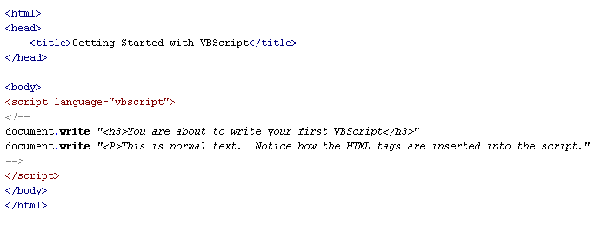
The document.write Method
An example from today’s mini-course:
The methods of the document object are used to creating an interactive web document

Slide 26
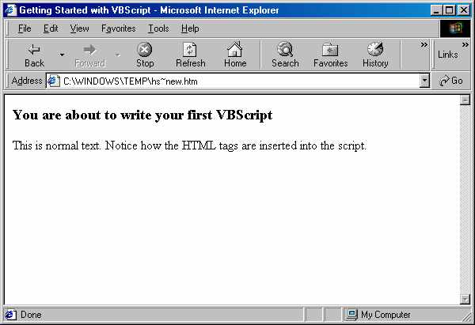
The result of the Document.write from previous slide

Slide 27
For the rest of the class meeting do the remaining part of the mini course
Click on the hyperlink below and finish the mini course by starting at lesson 10.
If you do not finish, you must do prior to our meeting in week 6 (week 5 is Chinese New Year holiday).
VBScript and ActiveX
After you finish the above course go to Chapter 4 of the online text book and finish the chapter titled
  Graphics and simple animation
Next week Monday and Tuesday you are on holidays. If you want to do anything for this course, I would suggest that you start to think about you project.

